Slide 1
The role of private equity/venture capital investors on portfolio firm earnings management
Brian K. Baik
MIT Sloan School of Management
May 2020

Slide 2
Research Question
Do PE/VC fund managers (GPs) influence the portfolio firms to engage in earnings management?

Slide 3
What does my paper do?
GENERAL PARTNER
ABC GP LLC
Fundraising FUND II
LP 2
e.g. CalPERS
LP 1
e.g. MIT Endowment
Abnormal NAV increase
… manipulation?
Jenkinson et al. 2013
Barber & Yasuda 2017
Brown et al. 2019
Management Fees
(2% of NAV)
Carried interest
(20% of realized returns)
Fund Mgmt
Capital Commitment
FUND II
… through managing earnings?
FUND I
Delay portfolio firm write-offs
Barber & Yasuda 2017
Chakraborty & Ewens 2018
100%
100%
100%
Portfolio Firm 1
Portfolio Firm 2
Portfolio Firm 3
EBITDA: £100
EV/EBITDA: 10x
Value: £1,000
EBITDA: £20
EV/EBITDA: 5x
Value: £100
EBITDA: £50
EV/EBITDA: 8x
Value: £400

Slide 4
Why is my question important?
Private equity literature – identifies PE/VC performance management at the portfolio firm level
Provide a case where institutional shareholders (GPs) demand earnings management, in contrast to prior findings
Enhance understanding of the relationship between private firms and their shareholders
Prior literature focuses on either comparing private firms to public firms, or debt contracting and private firm behavior

Slide 5
Hypothesis development
Theory predicts GPs have sufficient motivation to manage current fund performance
GPs often gain control of portfolio firms, by…
taking significant equity ownership
taking board memberships
replacing existing management
H1: When a GP is fundraising for their next fund, its portfolio firm engages in earnings management.
c

Slide 6
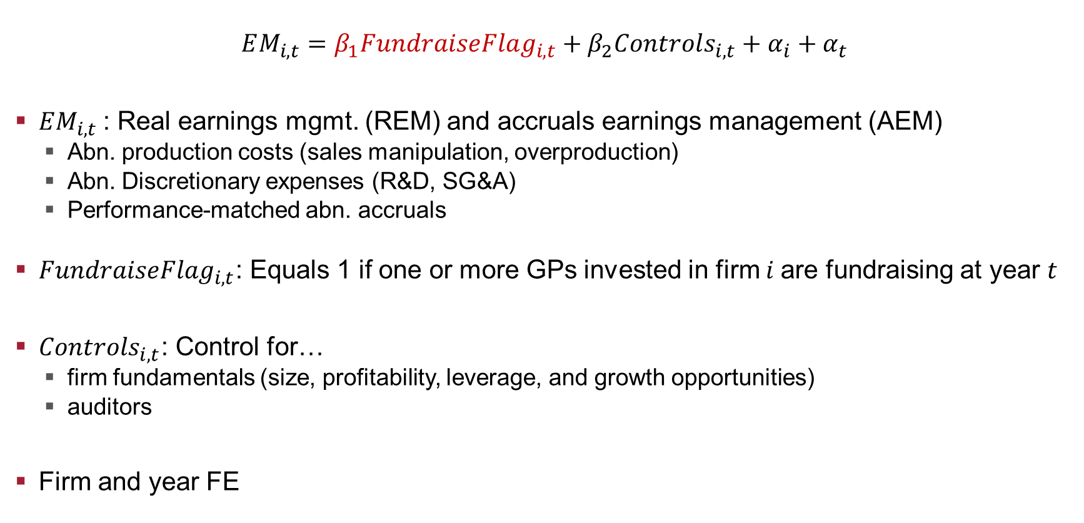
Research design
$$EM_{i,t}=β_{1}FundraiseFlag_{i,t}+β_{2}Controls_{i,t}+α_{i}+α_{t}$$
$EM_{i,t}$ : Real earnings mgmt. (REM) and accruals earnings management (AEM)
Abn. production costs (sales manipulation, overproduction)
Abn. Discretionary expenses (R&D, SG&A)
Performance-matched abn. accruals
$FundraiseFlag_{i,t}$: Equals 1 if one or more GPs invested in firm $i$are fundraising at year $t$
$Controls_{i,t}$: Control for…
firm fundamentals (size, profitability, leverage, and growth opportunities)
auditors
Firm and year FE
↑ prod ↑ REM
↓ disc. exp ↑ REM
↑ values ↑ AEM
Egs
ego

Slide 7
Main results – Table 4
 |  | Prod Cost | Disc Exp | Accruals
 | Pr. | (1) | (2) | (3)
FundraiseFlag | +,-,+ | 0.026** | -0.013 | -0.029
 |  | (2.50) | (-1.02) | (-1.30)
ln(Total Assets) |  | 0.043*** | 0.016 | 0.038
 |  | (3.75) | (1.30) | (1.61)
ROA |  | -0.190*** | -0.593*** | -0.007
 |  | (-4.60) | (-8.08) | (-0.08)
Leverage |  | 0.037** | -0.033 | -0.071**
 |  | (2.51) | (-1.09) | (-2.36)
Chg_sales |  | -0.003 | 0.397*** | -0.033*
 |  | (-0.22) | (22.63) | (-1.74)
Big4 |  | -0.019 | 0.053* | 0.036
 |  | (-0.91) | (1.73) | (0.82)
ln(Age) |  | -0.107*** | 0.083 | -0.057
 |  | (-2.59) | (1.38) | (-0.68)
Observations |  | 5,339 | 5,339 | 5,339
R-squared |  | 0.796 | 0.791 | 0.249
Firm FE |  | Yes | Yes | Yes
Year FE |  | Yes | Yes | Yes
Cluster |  | Industry x Year
GP fundraising event is associated with 2.6% higher abnormal production cost
No statistically significant relationship for abnormal discretionary expenses and accruals
Both PE and VC associated with long-run innovation
GPs may not be able to wind down long-run R&D projects
Accruals are easier to be detected when under scrutiny

Slide 8
Concern 1: Can the results be driven by performance?
 | Prod Cost | Disc Exp | Accruals
 | (1) | (2) | (3)
FundraiseFlag x NegSE | 0.065** | -0.099** | 0.091
 | (2.10) | (-1.96) | (1.12)
FundraiseFlag | 0.016 | 0.002 | -0.044*
 | (1.57) | (0.18) | (-1.76)
NegSE | -0.014 | 0.068* | -0.206***
 | (-0.56) | (1.74) | (-3.89)
Observations | 5,339 | 5,339 | 5,339
R-squared | 0.796 | 0.791 | 0.253
Controls | Yes | Yes | Yes
Firm FE | Yes | Yes | Yes
Year FE | Yes | Yes | Yes
Cluster | Industry x Year
Concern
Higher abnormal production costs may just be occurring from better portfolio firm performance
Results stronger for weaker firms
Interact FundraiseFlag and NegSE, an indicator for negative SE firms
NegSE firms have 6.5pp higher abn. Production costs and 9.9pp lower abn. disc. expenses

Slide 9
Concern 2: Isn’t this what GPs do?
 | Prod | Disc exp | Accruals
 | (1) | (2) | (3)
Post | -0.011 | 0.039*** | 0.049**
 | (-0.86) | (2.76) | (2.10)
Observations | 8,724 | 8,724 | 8,724
R-squared | 0.757 | 0.780 | 0.236
Controls | Yes | Yes | Yes
Firm FE | Yes | Yes | Yes
Year FE | Yes | Yes | Yes
Cluster | Industry x Year
Concern
GPs could be accelerating production/reducing disc. expenses once they take ownership of the portfolio firm
Possibly capturing “what PE/VCs are good at”
Effects of GP ownership on EM
Regress EM measures on Post, to examine the effects of PE/VC ownership on EM
REM decreases post GP ownership; thus REM does not seem to be what PE/VCs do in normal times

Slide 10
Next steps
Cross-sectional tests
Equity ownership/board seats/management
GP experience/reputation
Consequences of EM
Does REM work for future fundraising success?
Brown et al. 2019: LPs look through fund overvaluation/manipulation

Slide 11
Thank you

Slide 12
Why is fundraising important for GPs?
First Close
Year | …5 | 6 | 7 | 8 | 9 | 10 | …
FUND I | Investment phase |  | Divestment phase
FUND II |  |  |  |  | Marketing |  | Investment phase
Earnings Management
Second Close

Slide 13

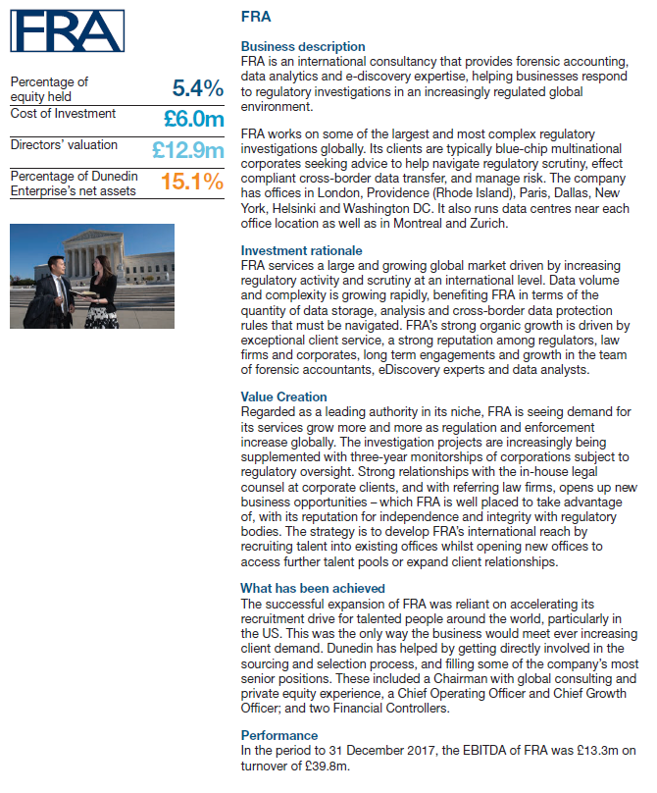
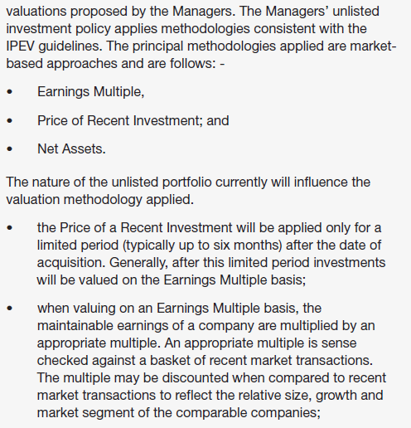
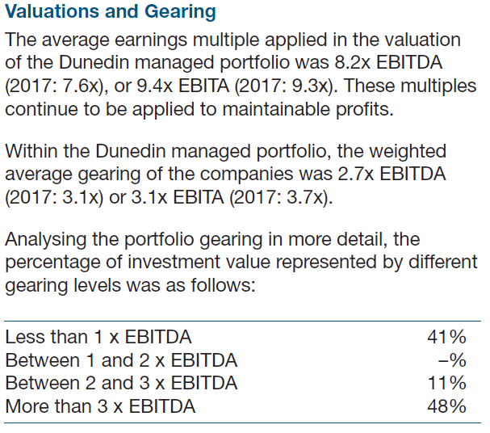

Slide 14
Data
Preqin
Global list of PE/VC transactions, GP fundraising information
Sources from FOIA requests, media articles, GP contributions
Name match
FAME
Portfolio firm financial statements
BvD dataset – 3 million firm-year observations of UK public/private company financial statements

Slide 15
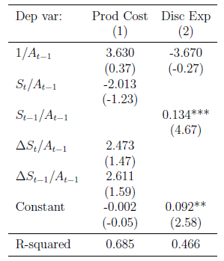
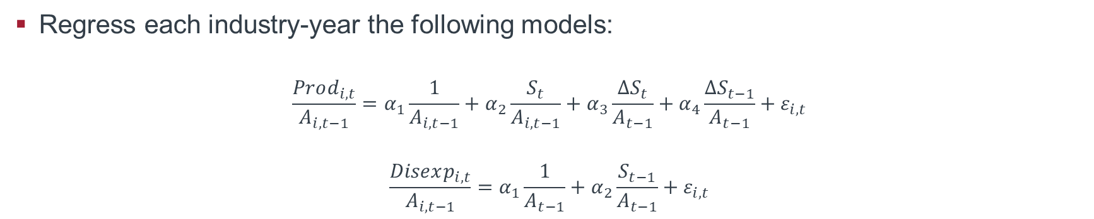
How do I measure REM?
Regress each industry-year the following models:
$$\frac{Prod_{i,t}}{A_{i,t−1}}=α_{1}\frac{1}{A_{i,t−1}}+α_{2}\frac{S_{t}}{A_{i,t−1}}+α_{3}\frac{ΔS_{t}}{A_{t−1}}+α_{4}\frac{ΔS_{t−1}}{A_{t−1}}+ε_{i,t}$$
$$\frac{Disexp_{i,t}}{A_{i,t−1}}=α_{1}\frac{1}{A_{t−1}}+α_{2}\frac{S_{t−1}}{A_{t−1}}+ε_{i,t}$$
↑ Residuals
↑ REM
↓ Residuals
↑ REM

Slide 16
Null
GPs are under greater scrutiny during fundraising periods
Other factors may be more important for successful fundraising than portfolio firm performance
Decision of existing fund LPs to re-invest
Realized returns than unrealized portfolio firm performance
back

